Slide 1
Team -C
28805- Deep Raghuwanshi
28806- Kundan Keshav Gawade
28807- Prajwal Thangan
28809- Devashish Lokhande
29080- V.S Goptherya
29084- Thulsi Ram

Slide 2
Week- 2 Day-1
Topics –
OSI/TCP Model- Kundan Keshav Gawade
Port and types of Port- Thulsi Ram
Network Architecture- Devashish Lokhande
Topologies in Network Architecture- Prajwal Thangan
IP Address and Types of IP Address- V.S Goptherya
Wireshark- Deep Raghuwanshi

Slide 3


Slide 4
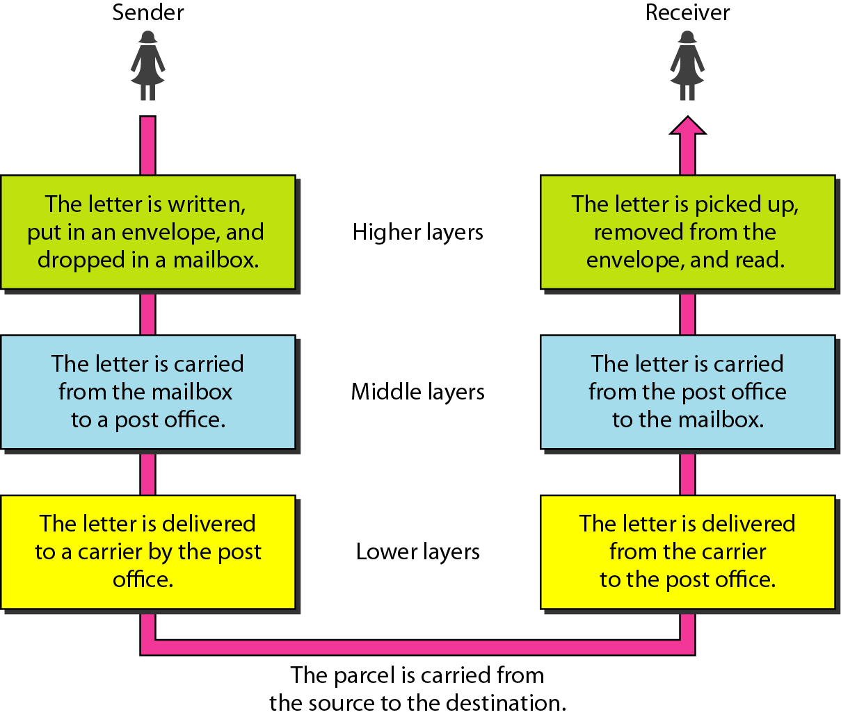
Real Time Example

Slide 5
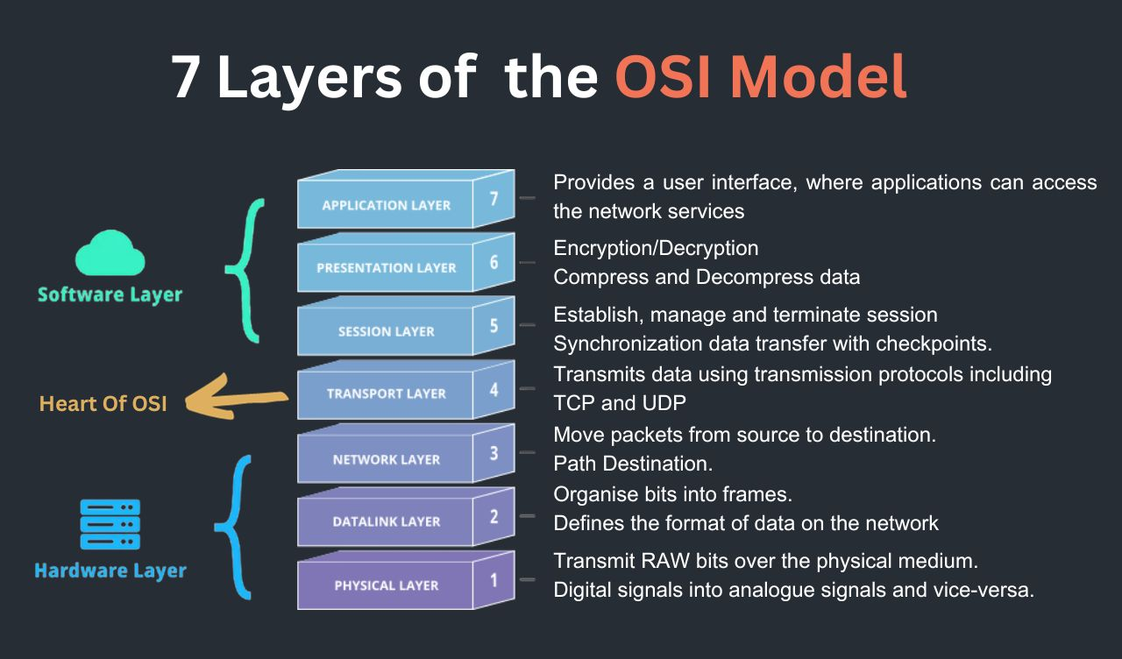
OSI Model

Slide 6
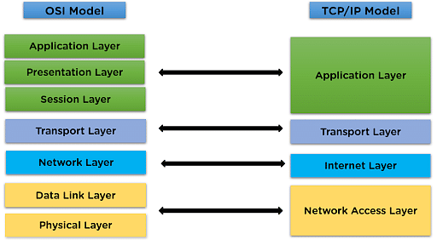
TCP/IP

Slide 7
PORTS AND TYPES OF PORTS

Slide 8
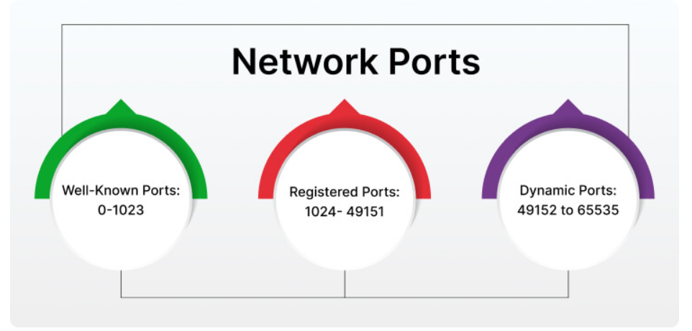
Types of Ports

Slide 9
Well-Known Ports
HTTP(80): Transfers web pages and content from a server to your web browser.
HTTPS(443):It is secure version of HTTP,Encrypts data between your browser and server using TLS/SSL
FTP(21):Transfer files between a client and a server over a network
SSH(22): Secure remote login and command execution on another computer over a network.
DNS(53): Turns domain names into IP addresses, which browsers use to load internet pages.

Slide 10
Registered Ports
Registered ports are TCP and UDP ports from 1024 to 49151
They are assigned by the Internet Assigned Numbers Authority (IANA) to specific services, applications, or protocols.

Slide 11
Dynamic Ports
These ports are not assigned to any specific service.
Used temporarily by client devices to establish outbound connections.
Automatically assigned by the operating system when an application requests a network connection

Slide 12
Network Architecture
Overview, Types, and Topologies
Team C – 22809 Devashish L

Slide 13
Introduction to Network Architecture
Network Architecture refers to the design and structure of a computer network. It defines how devices (like computers, servers, and routers) are connected, how they communicate, and how resources are shared across the network.
Overview:
- It provides a blueprint for building and managing networks.
- Specifies the roles of devices (client, server, peer, etc.).
- Determines the communication protocols, data flow, and network topology.
- A well-designed network architecture ensures efficiency, scalability, and security.

Slide 14
Types of Network Architecture
Client-Server Architecture
• One central server
• Multiple client machines
• Examples: Websites, Amazon, ATM

Slide 15
Peer-to-Peer (P2P) Architecture
- All devices act as both clients and servers
- Devices can share resources directly
- Example: Torrent file sharing, Bluetooth, LAN Gaming

Slide 16
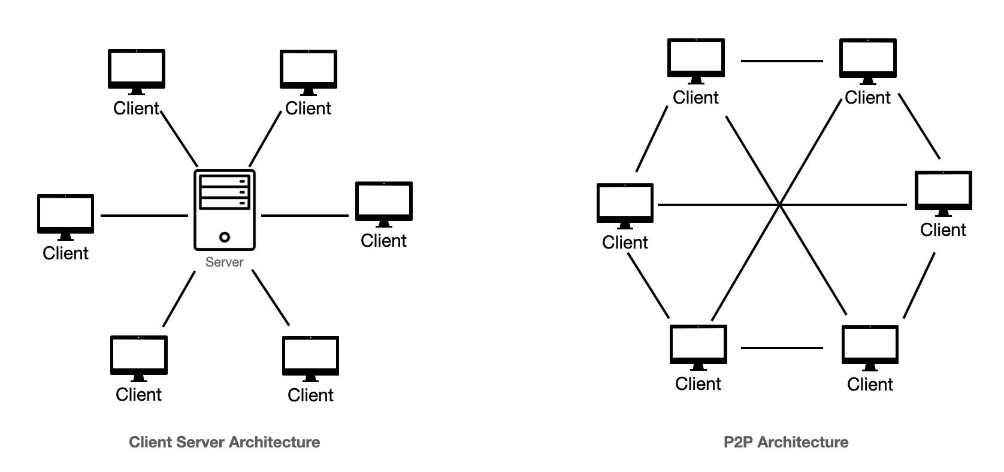

Slide 17
Hybrid Architecture
- Combination of Client-Server and Peer-to-Peer
- Offers flexibility and better resource distribution
- Example: Microsoft Teams uses servers to store and send your chats and files (client-server), but when you make a call, it often connects your device directly to your friend’s for faster performance (peer-to-peer). That’s why it’s called a hybrid model.

Slide 18
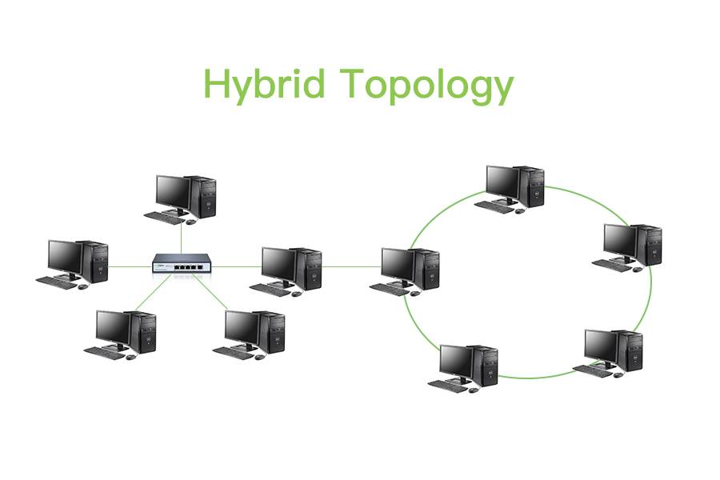

Slide 19
Network Topologies
- Topology: The physical/logical layout of a network
- Types:
• Bus
• Star (most common)
• Ring
• Mesh

Slide 20
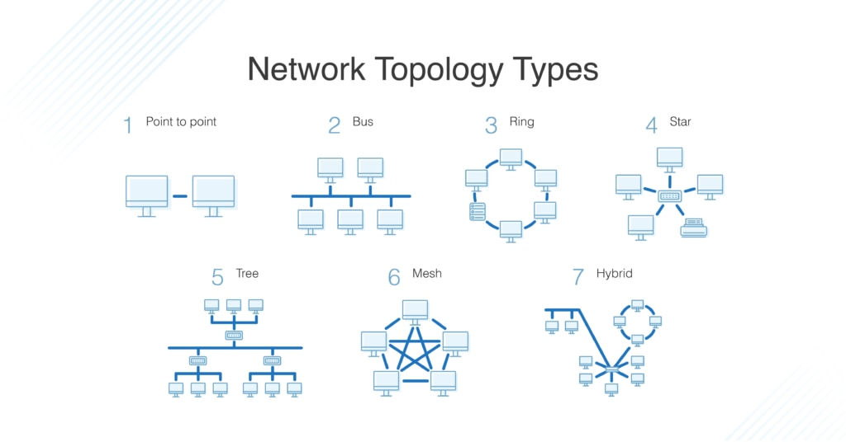

Slide 21
Most Common Topology – Star
- All systems connect to a central hub/switch
- Easy to manage and troubleshoot
- Example: Office LAN setup

Slide 22
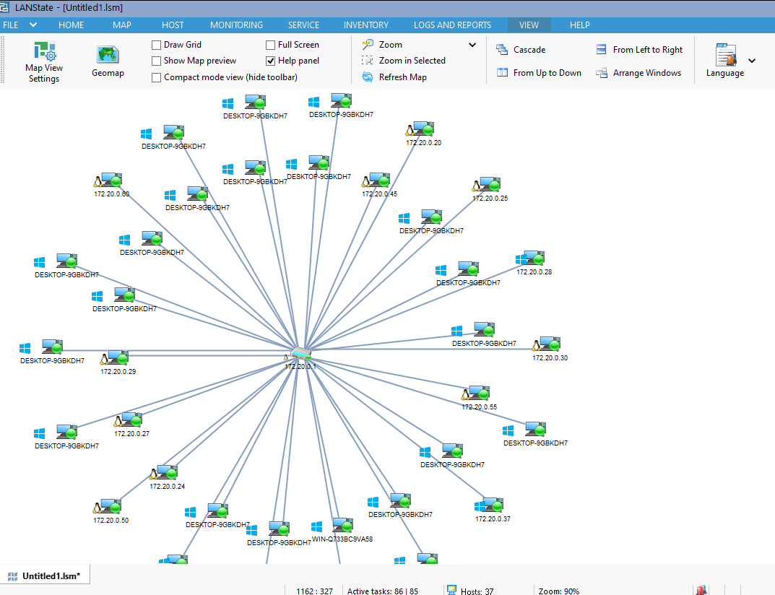

Slide 23
Summary
- Network architecture is crucial for efficient communication
- Three main types: Client-Server, P2P, and Hybrid
- Common topologies include Star, Bus, Ring, and Mesh

Slide 24
Network Topologies -28807-Prajwal Thangan
A network topology refers to the physical or logical layout of devices (nodes) in a network. It defines how devices are connected and how data flows between them.

Slide 25
Types Bus: All devices share a single communication line. Star: All devices connect to a central hub or switch. Ring: Devices form a closed loop where data travels in one direction. Mesh: Every device is directly connected to every other device. Tree: A hierarchical structure combining star and bus topologies. Hybrid: A combination of two or more different topologies

Slide 26
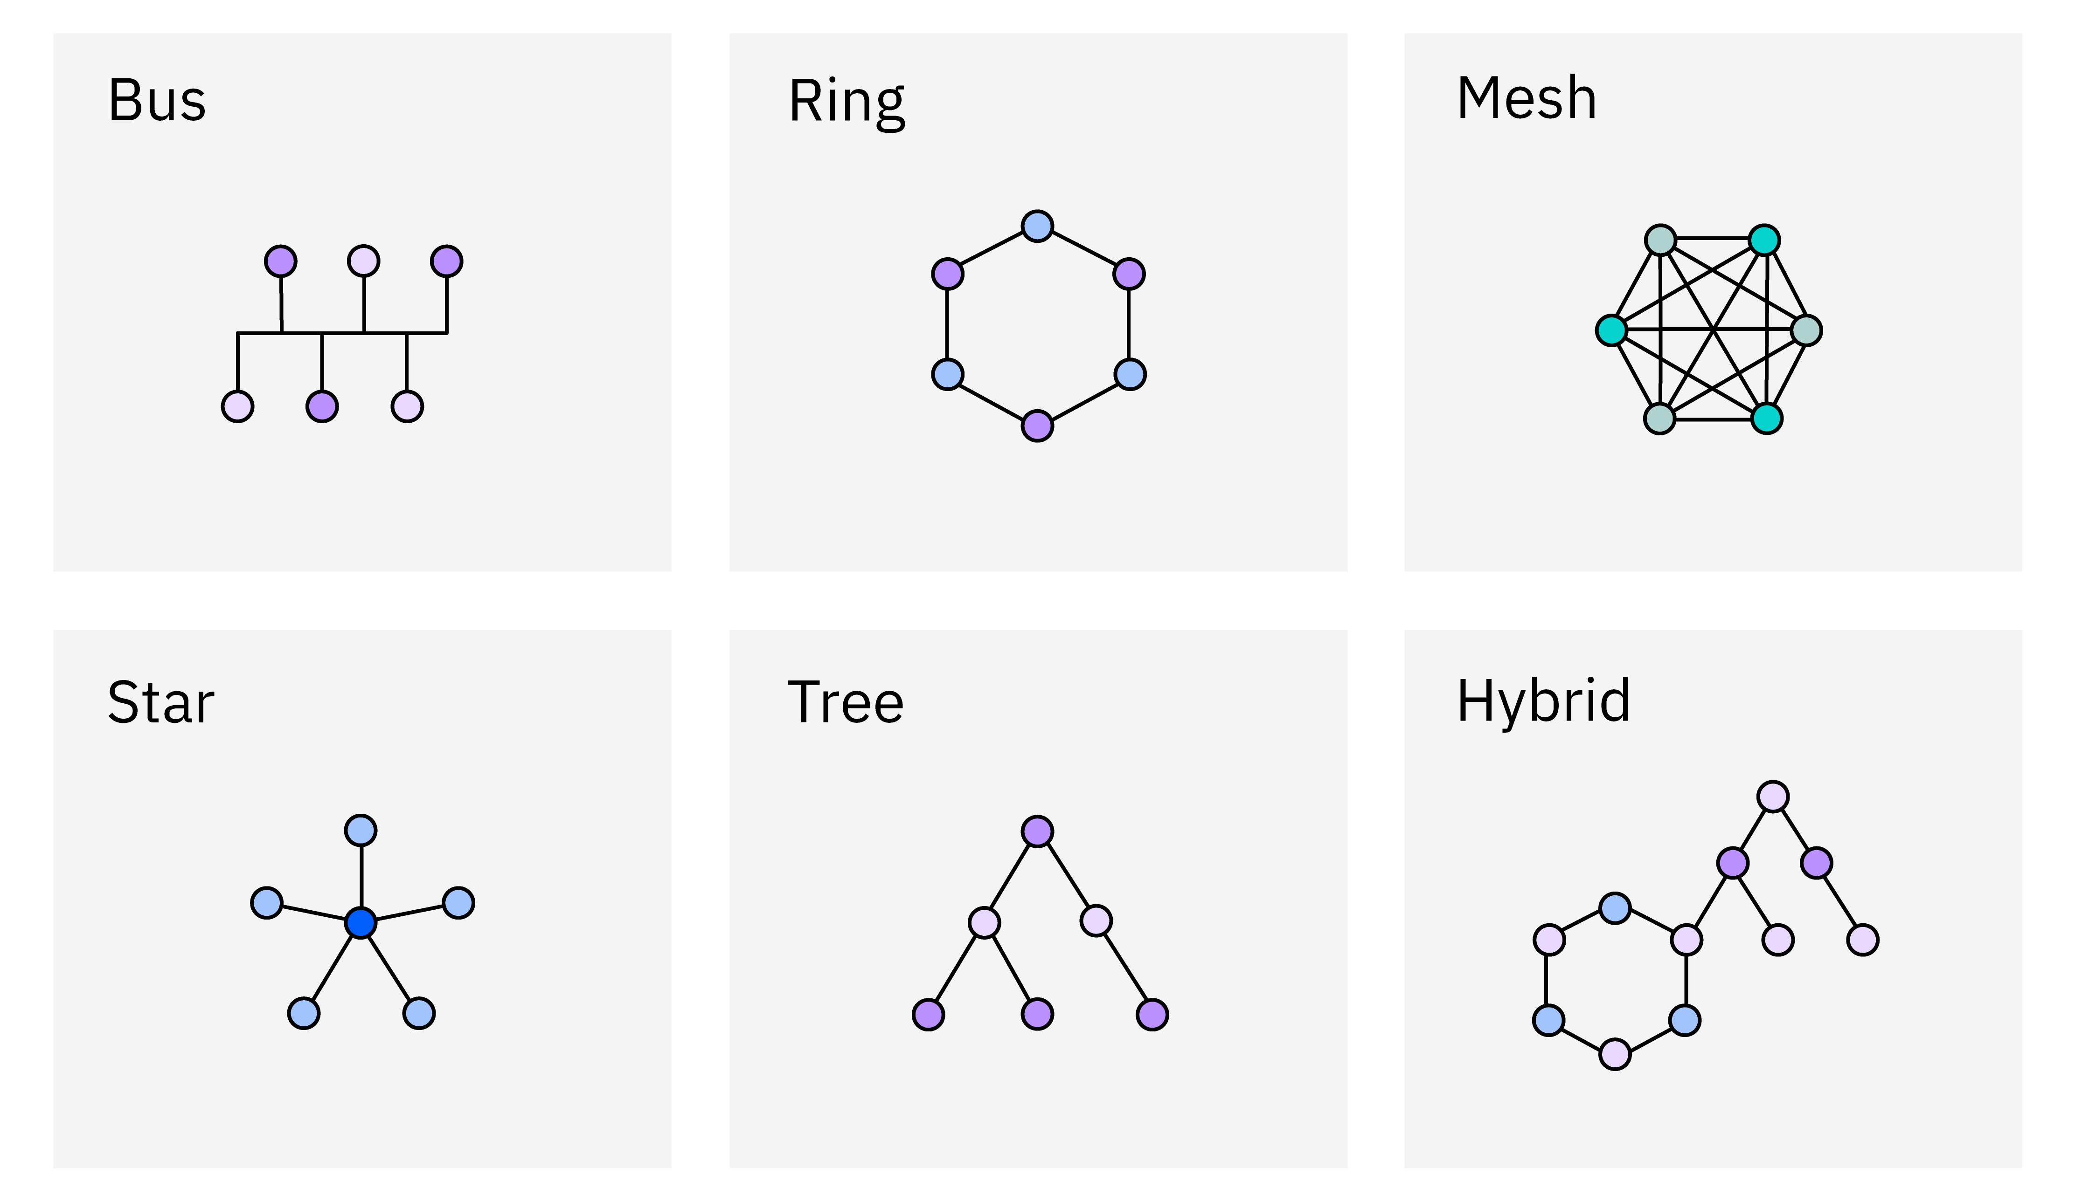

Slide 27
Topology | Cost | Reliability | Complexity | Use Case
Bus | Low | Low | Low | Small networks
Star | Medium | Medium | Low | Offices, homes
Ring | Medium | Medium | Medium | MANs (metro networks)
Mesh | High | High | High | Military, critical systems
Tree | Medium | Medium | Medium | Large organizations
Hybrid | High | High | High | Data centers, enterprise networks

Slide 28
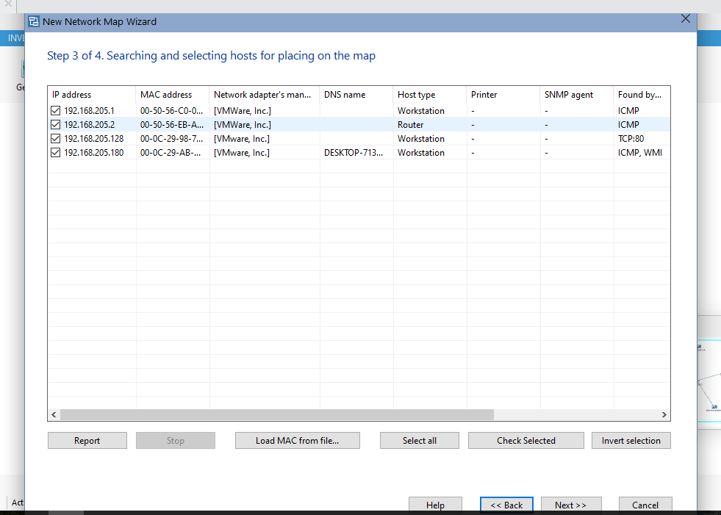

Slide 29
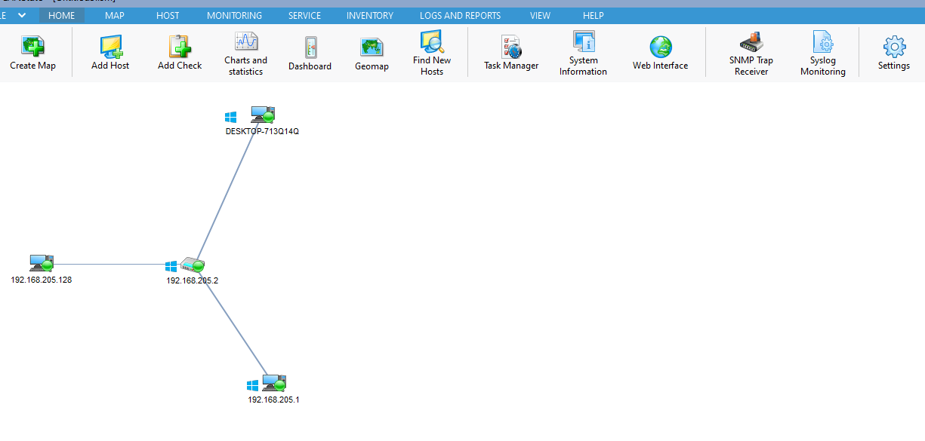

Slide 30
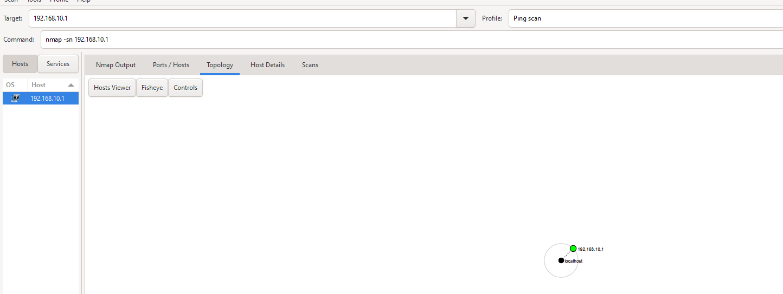

Slide 31
Understanding IP Addressing, NAT, APIPA and CIDR

Slide 32
What is an IP Address?
An IP address (Internet Protocol address) is a unique identifier for a device on a network.
IPv4: 32-bit (e.g., 192.168.1.1)
IPv6: 128-bit (e.g., 2001:0db8:85a3::8a2e:0370:7334)
Used for identifying devices and routing traffic across networks.

Slide 33
Types of IP Addresses
1. Public IP: Used on the internet, globally unique.
2. Private IP: Used in local networks (e.g., 192.168.x.x).
3. Static IP: Manually assigned and does not change.
4. Dynamic IP: Assigned by DHCP and may change over time.

Slide 34
Commands to View/Configure IP Settings
Windows:
- ipconfig /all
- ipconfig /release & ipconfig /renew
Linux/macOS:
- ifconfig (older) or ip addr show
- sudo dhclient (renew IP)
- ip route (view routing table)

Slide 35
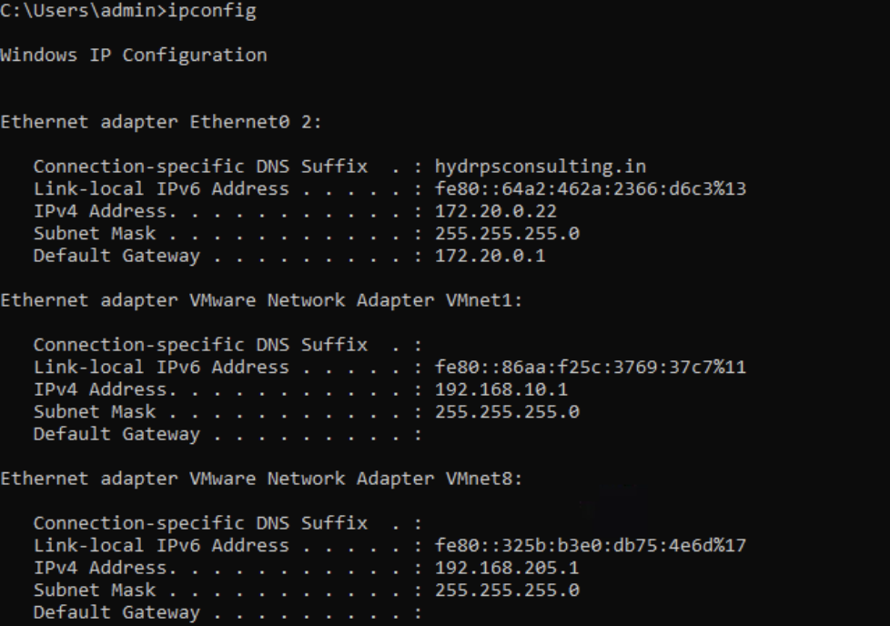
Open command prompt in your pc to check your ip address. -ipconfig, type this command.

Slide 36
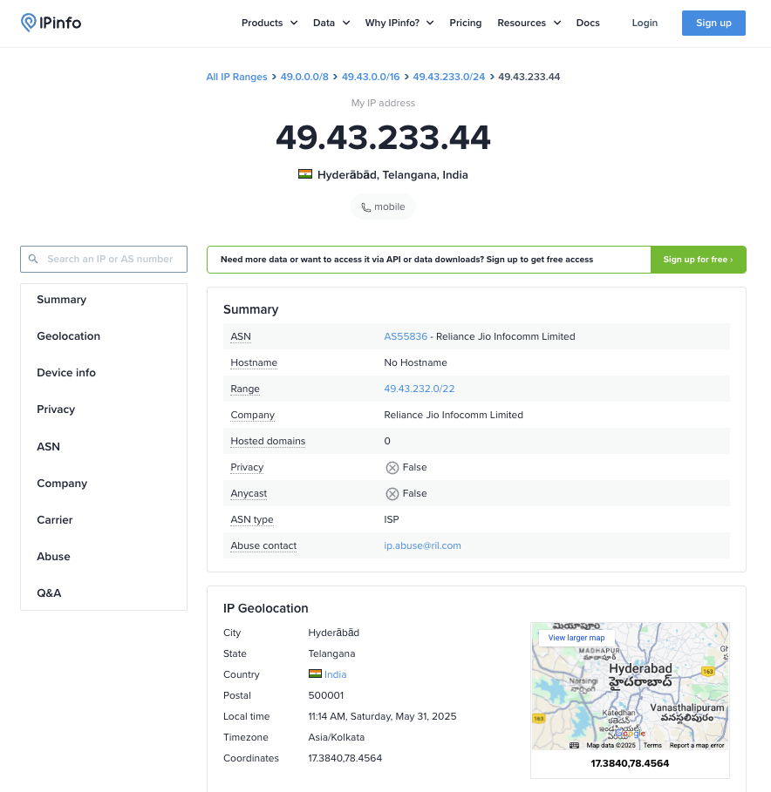
If you want know more info about the ip add as location, organization, etc Then go to a website called ‘ipinfo’

Slide 37
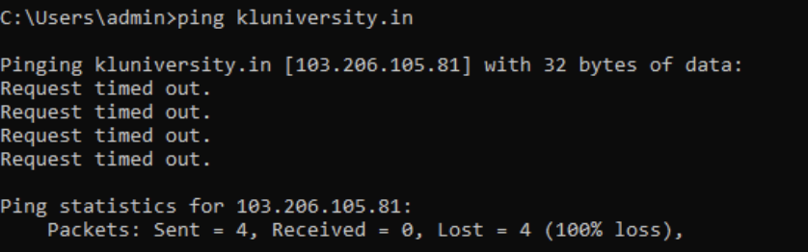
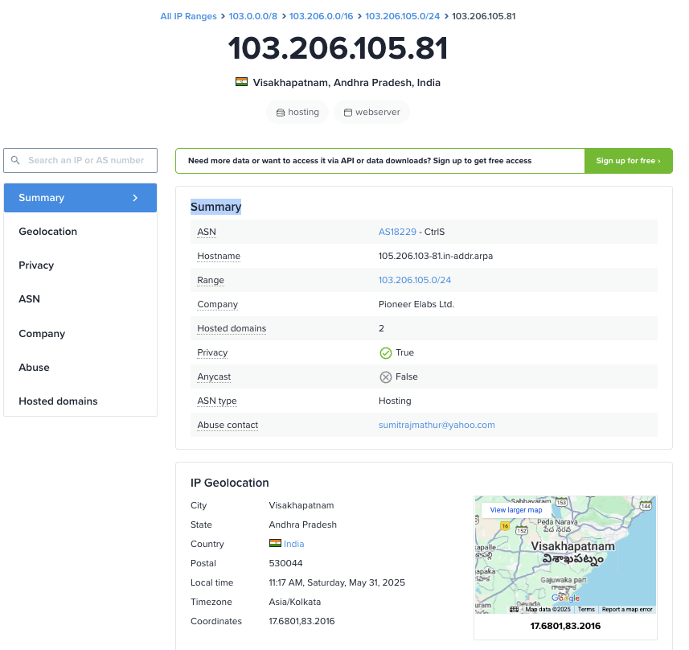
If you want to know any other domains/website ip add. Then go to cmd and type this command: ping <domain>, here we get ip add.
Then go back to the website ‘ipinfo’ and upload the ip.

Slide 38
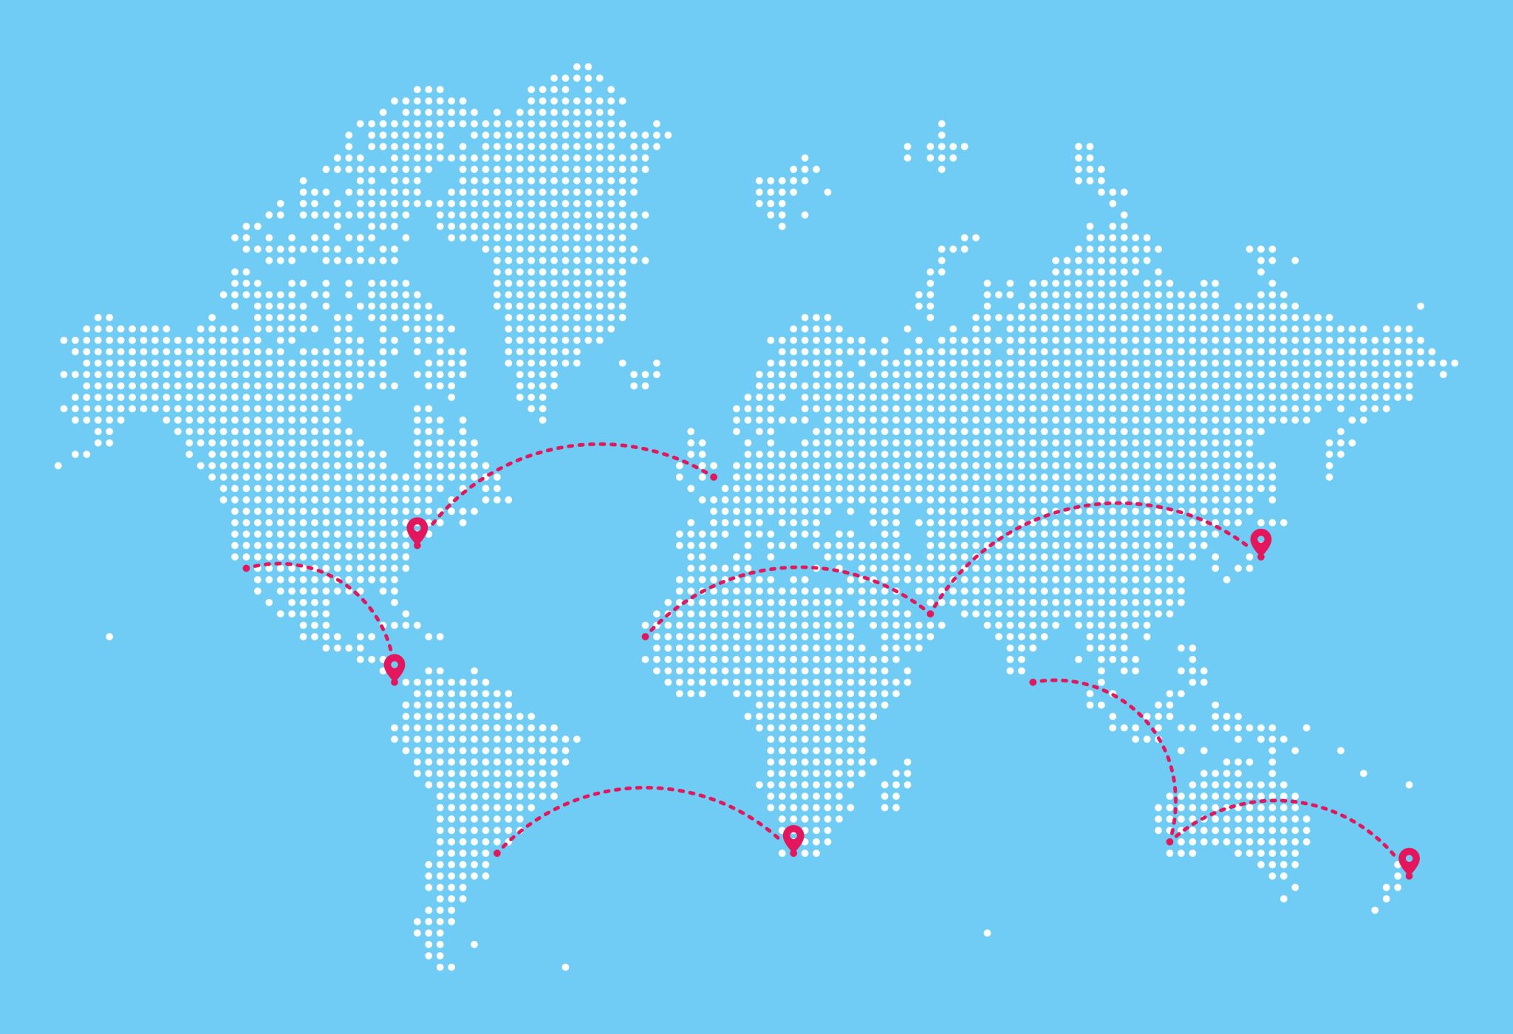
NAT (Network Address Translation)
NAT allows multiple devices on a local network to share a single public IP.
- Types:
• Static NAT: One-to-one mapping.
• Dynamic NAT: Uses a pool of public IPs.
• PAT (Port Address Translation): Many-to-one mapping using ports.
Example: 192.168.0.2 → 203.0.113.5
NAT allows multiple devices to share one public IP.

Slide 39

APIPA (Automatic Private IP Addressing)
APIPA is a feature in Windows operating systems that allows a computer to automatically assign itself an IP address and subnet mask when it cannot obtain one from a DHCP server.
Range: 169.254.0.1 to 169.254.255.254
Subnet Mask: The subnet mask for APIPA addresses is typically 255.255.0.0.
Used for local communication only (no internet).
Example: 169.254.10.23
APIPA: 169.254.1.5 (no DHCP)

Slide 40
CIDR (Classless Inter-Domain Routing)
CIDR replaces traditional IP classes and uses prefix notation (e.g., /24).
Example: 192.0. 2.0/24 is an IPv4 CIDR address where the first 24 bits, or 192.0. 2, is the network address.
Allows efficient IP allocation and routing.
CIDR Notation = IP Address + '/' + Prefix length
CIDR improves IP allocation and routing.

Slide 41

Examples of IP and Subnets
IPv4: 192.168.1.10/24
IPv6: fe80::1ff:fe23:4567:890a/64
CIDR: 10.0.0.0/8 covers 16 million addresses
APIPA: 169.254.1.5 (no DHCP)
Public IP: 8.8.8.8 (Google DNS)

Slide 42
Wireshark
Wireshark is a free and open-source network protocol Analyzer.
Used for network troubleshooting, analysis, software and communications protocol development.

Slide 43
Features of Wireshark
Filters packets using display filters.
Protocol-level analysis (TCP, DNS, HTTP, etc.)
Exporting data for audit/logging.
Captures and displays packet data in real-time.

Slide 44
Practical
Capture HTTP traffic on port 80 to detect if sensitive data is being transmitted in plain text.

Slide 45
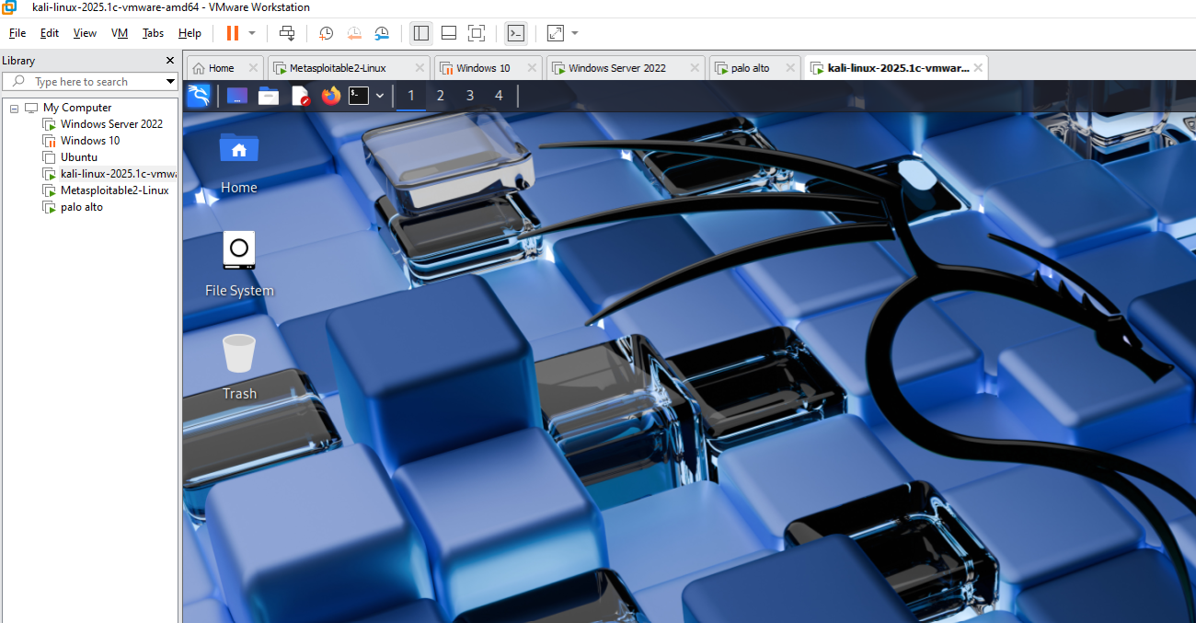
1. First we open Kali Linux

Slide 46
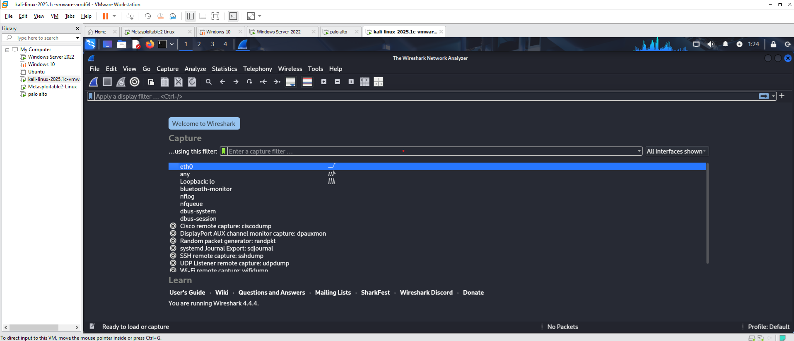
2. Then Wireshark which we can see on top left corner.

Slide 47
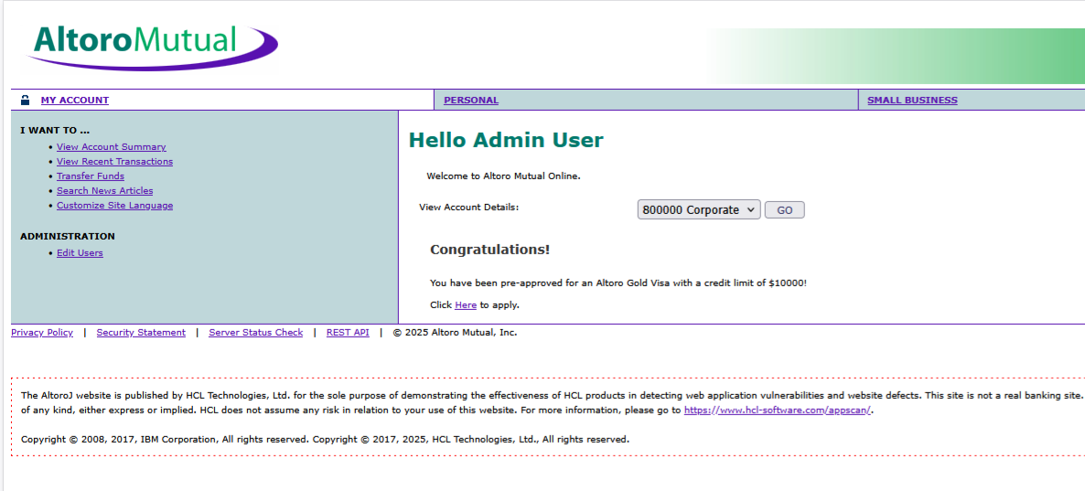
3. Open a browser And type demo.testfire.net and sign in

Slide 48
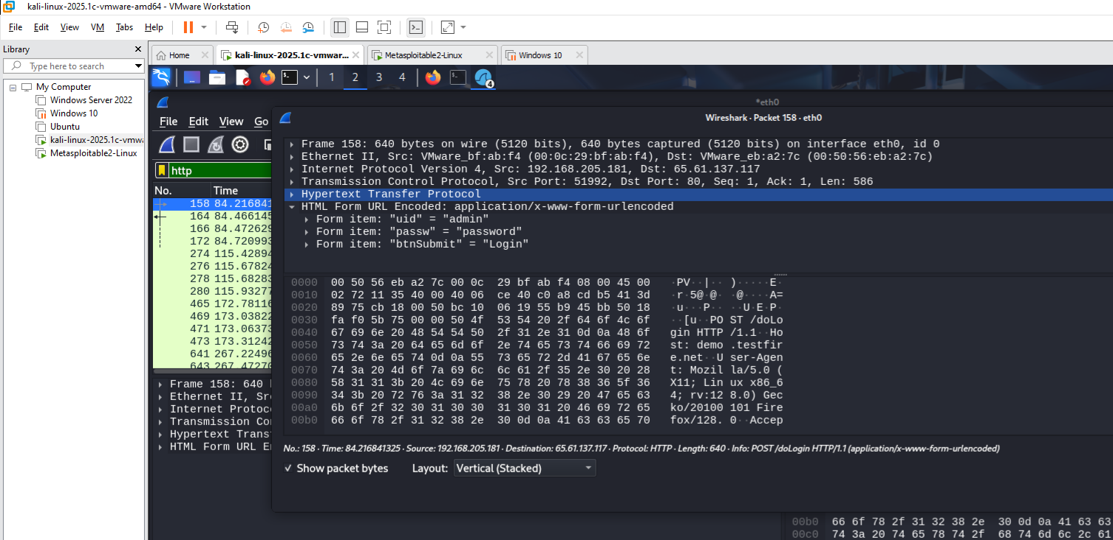
4. Then type HTTP filter and Double click HTTP post

Slide 49
5. There we see last option click on it

